Slide 1



CC switching to ACC
This presentation provides an overview of Adaptive Cruise Control (ACC) systems. ACC is a key technology for autonomous ground vehicles. We will cover the basics of ACC, its aims, and its function. We hope you find the presentation informative.
by Pars ÖNER

Slide 2

Adaptive Cruise Control Defined
ADAS Feature
Sensor Input
ACC is an advanced driver-assistance system. It automatically adjusts speed. It maintains safe distance.
Control uses on-board proximity sensors. Sensors include radar, cameras, or lidar.
Road Capacity
ACC increases road capacity. It maintains optimal separation between vehicles.

Slide 3
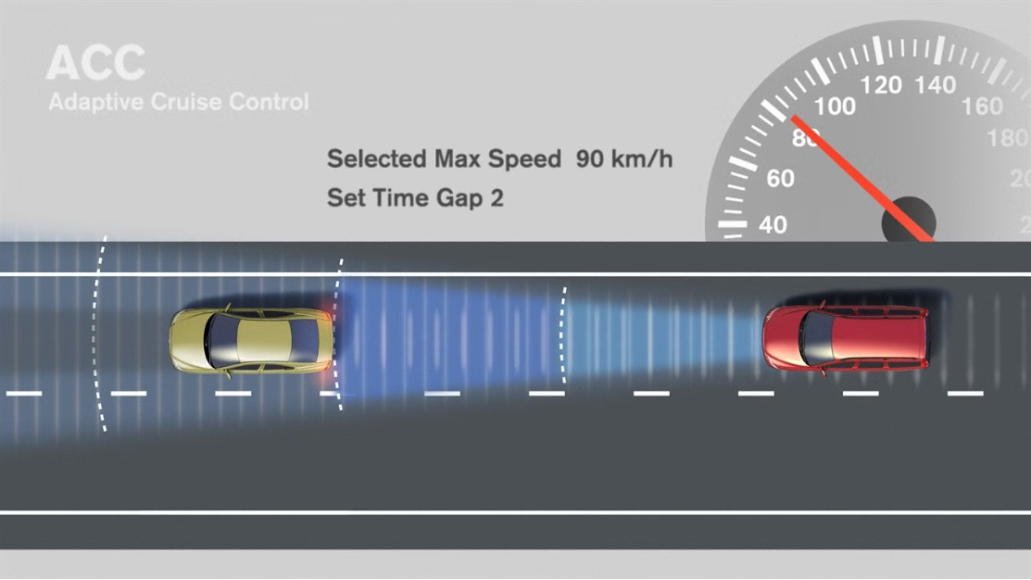
ACC System Dynamics
Longitudinal Control
Control Action
The ACC system acts on the longitudinal dynamics. This is key for autonomous driving.
It computes the control action. The vehicle reaches and maintains speed. It maintains safe distance.

Slide 4

Aim of ACC
1
Vehicle Feedback
2
Sensor Data
3
Relative Metrics
ACC uses feedback. It monitors absolute speed and position.
It uses ranging sensor information. Sensors detect distance and speed.
ACC determines relative distance and speed. These metrics are used for control.

Slide 5
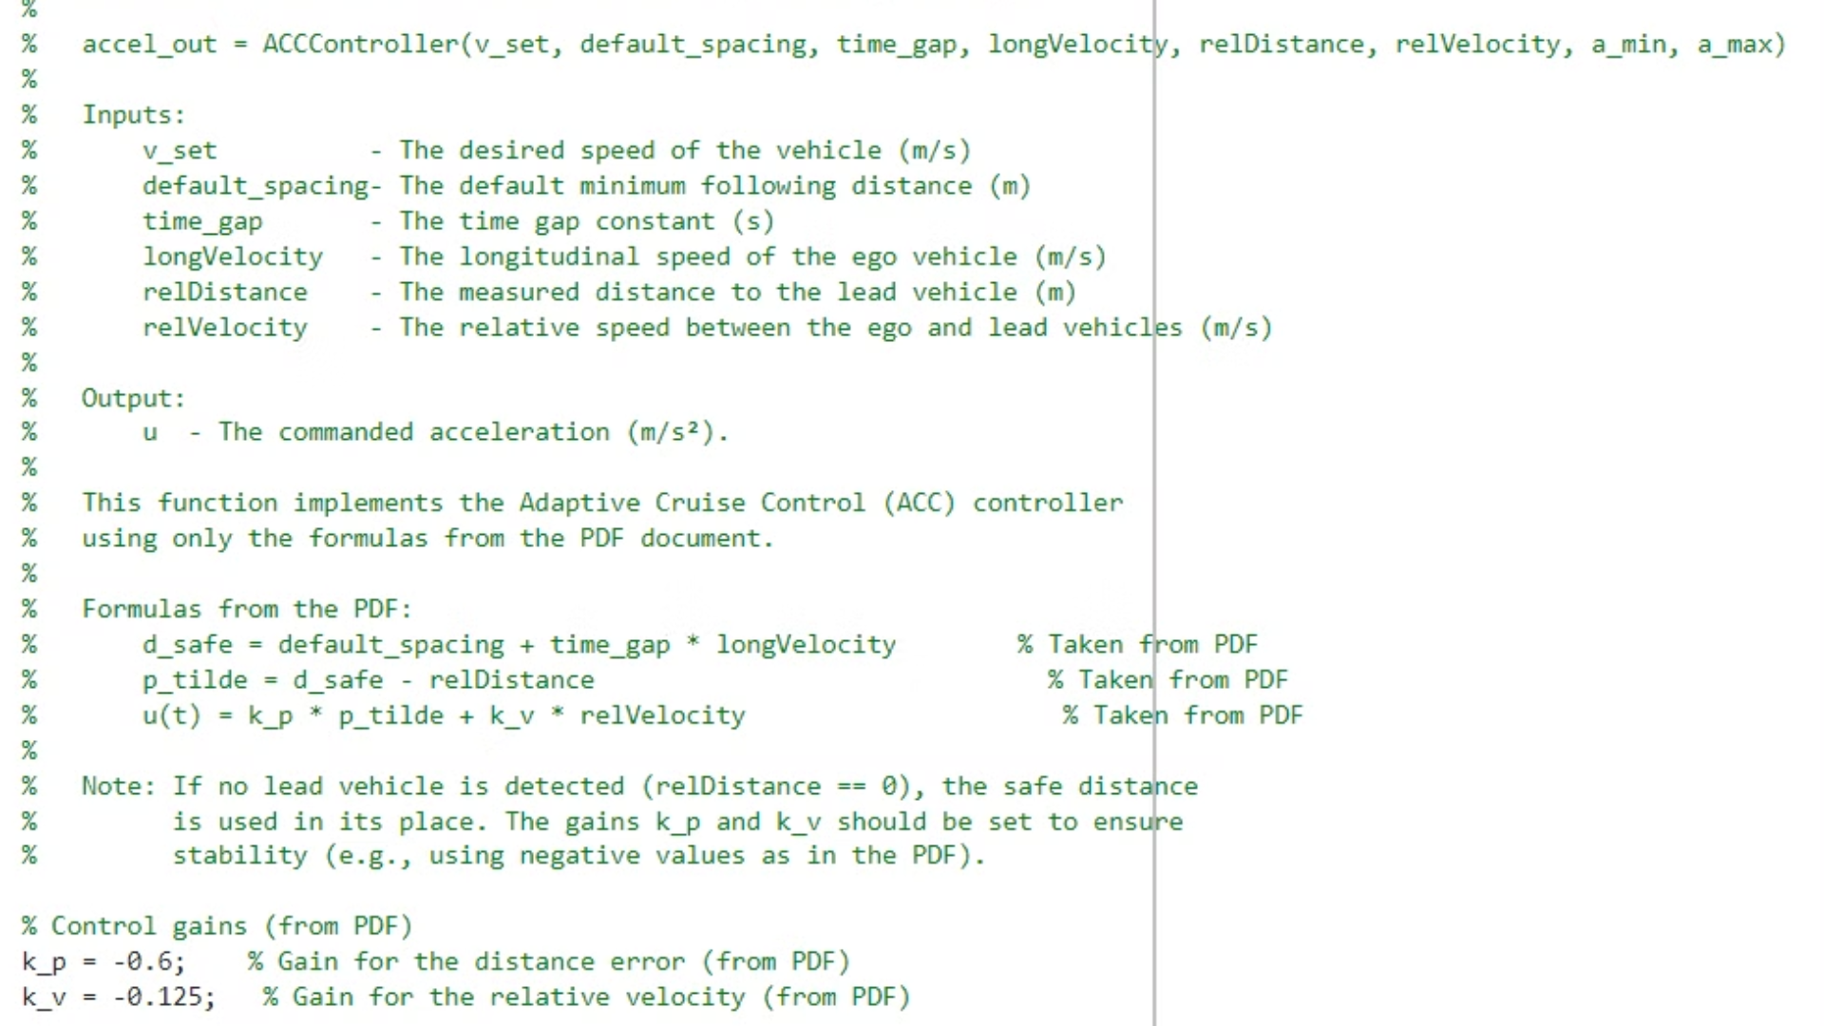
ACC Function Block
This diagram outlines the key function blocks within an ACC system. Understanding these blocks is crucial for developing effective ACC.

Slide 6
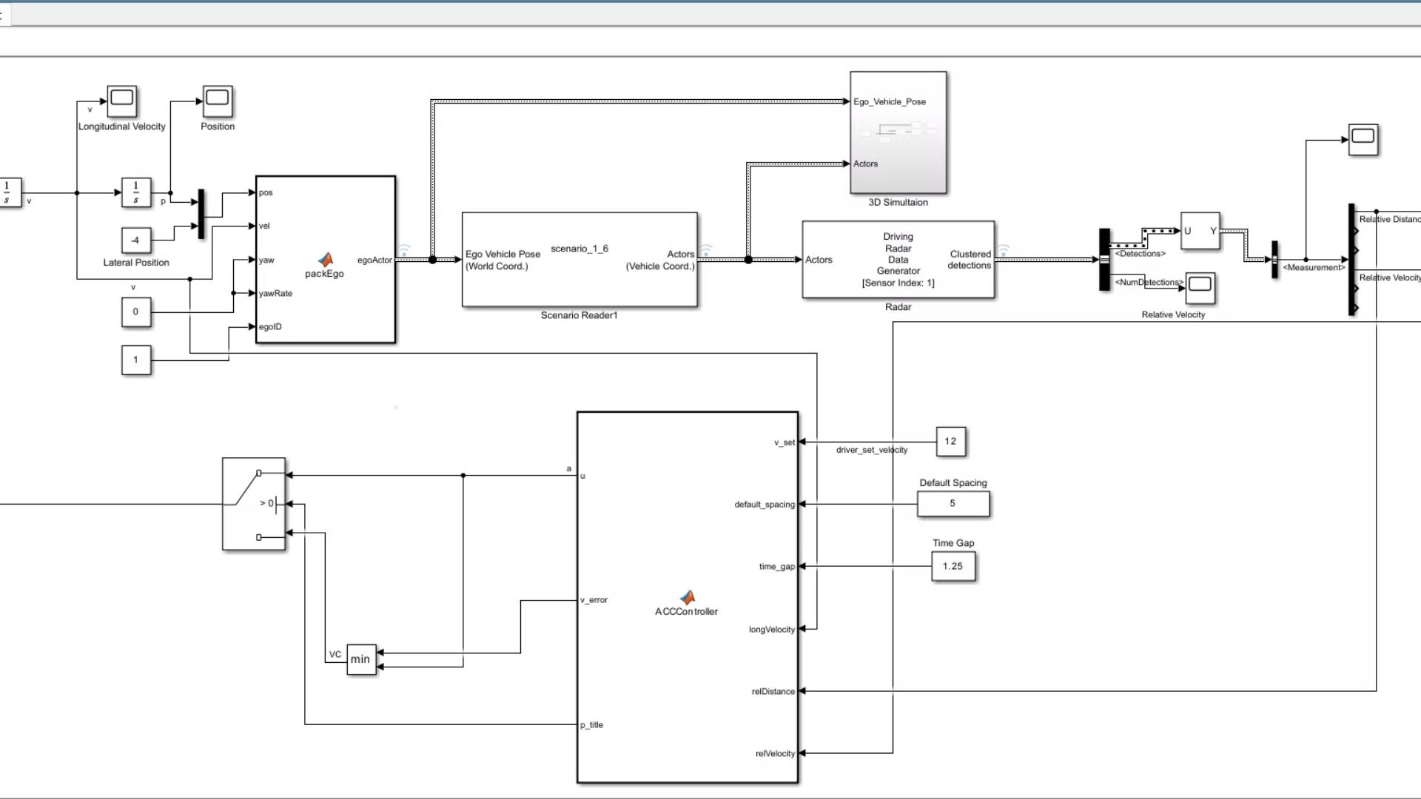



Key Takeaways
ACC Enhances Safety
ACC Improves Traffic Flow
ACC Reduces Driver Fatigue
ACC helps to prevent collisions by maintaining a safe following distance.
ACC can optimize traffic flow by smoothing out speed variations.
ACC automates some driving tasks, reducing strain on the driver.

